Slide 2
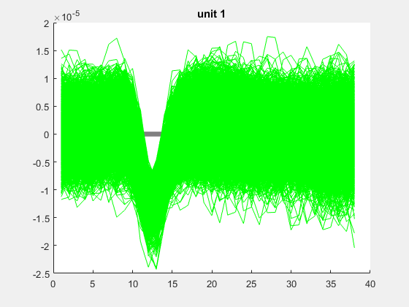
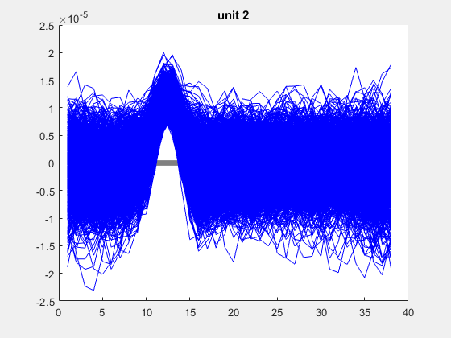
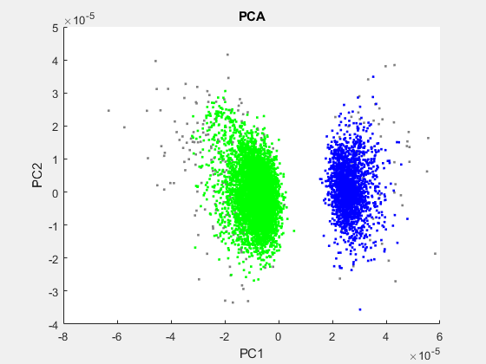
2-3-22_SampleElec_15min Electrode A6_11
All Valid WFs: | 8676
Unsorted WFs: | 284

Slide 3
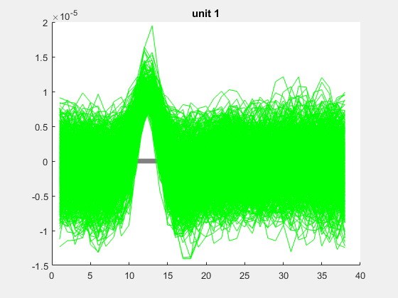
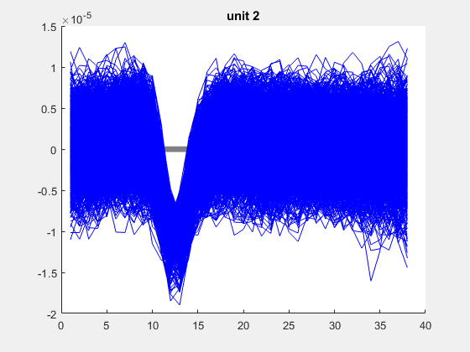
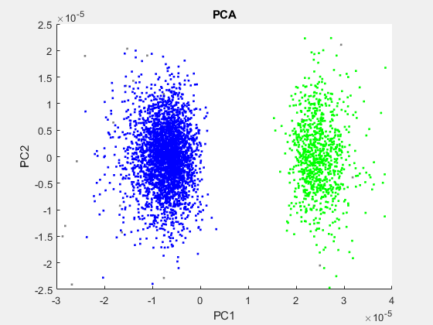
2-3-22_SampleElec_15min Electrode A6_12
All Valid WFs: | 4196
Unsorted WFs: | 29

Slide 4
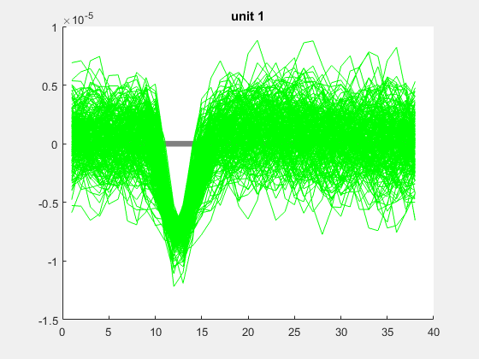
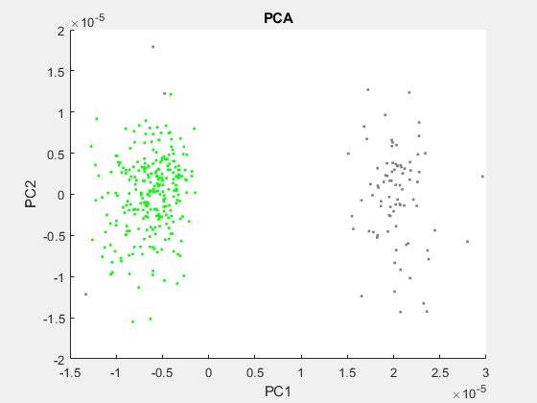
2-3-22_SampleElec_15min Electrode A6_13
All Valid WFs: | 349
Unsorted WFs: | 85

Slide 5
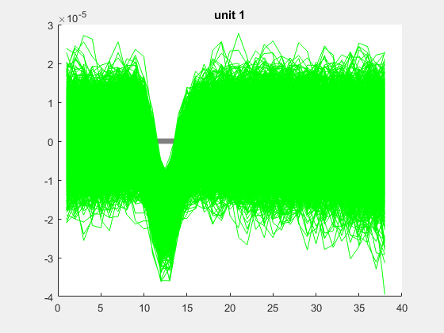
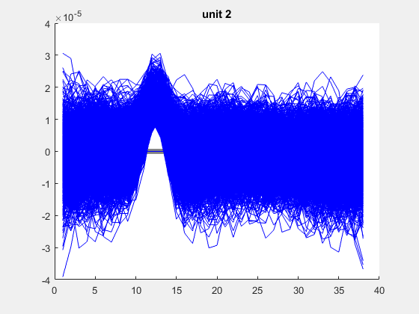
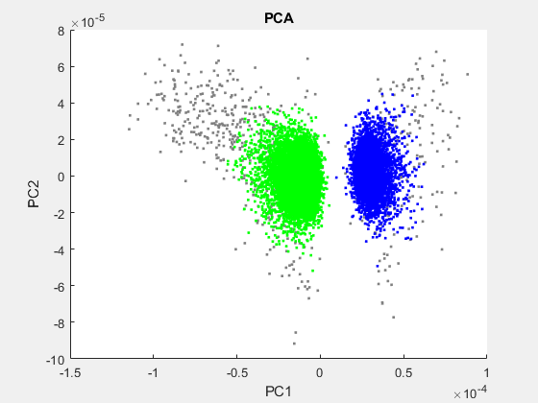
2-3-22_SampleElec_15min Electrode A6_21
All Valid WFs: | 17367
Unsorted WFs: | 776

Slide 6
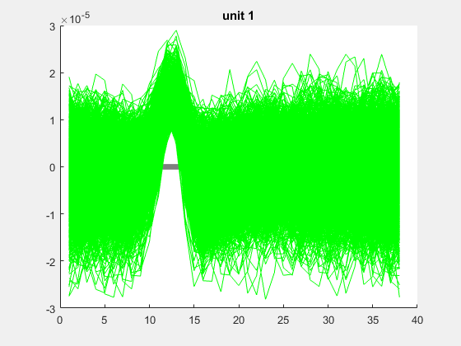
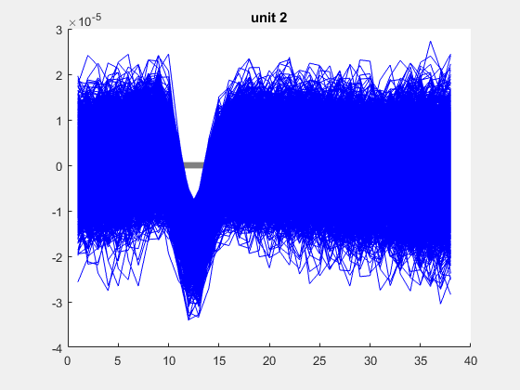
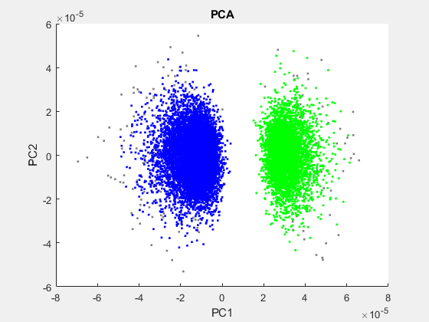
2-3-22_SampleElec_15min Electrode A6_22
All Valid WFs: | 16340
Unsorted WFs: | 399

Slide 7
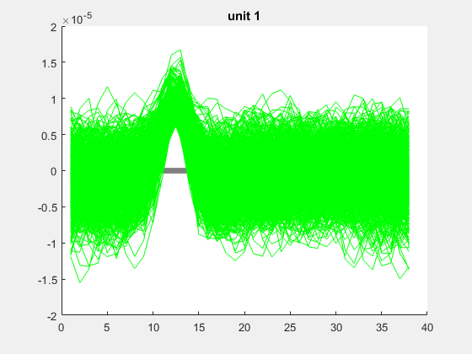
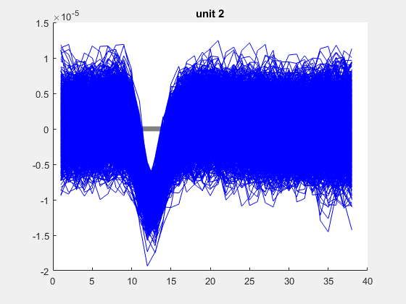
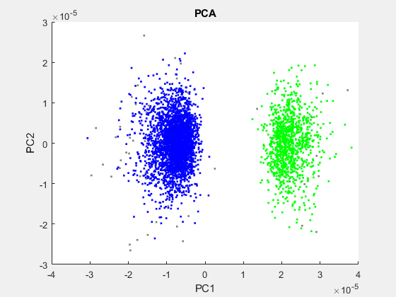
2-3-22_SampleElec_15min Electrode A6_23
All Valid WFs: | 4174
Unsorted WFs: | 59

Slide 8
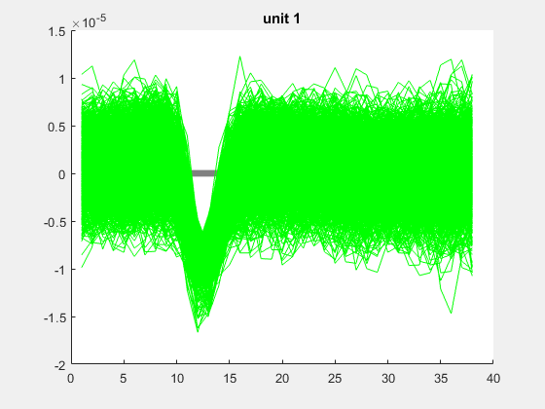
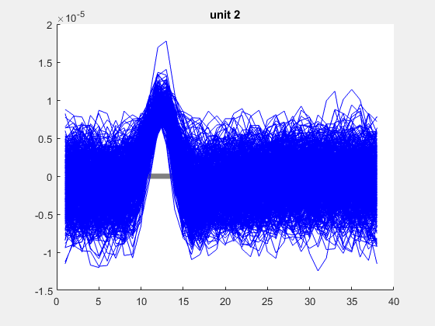
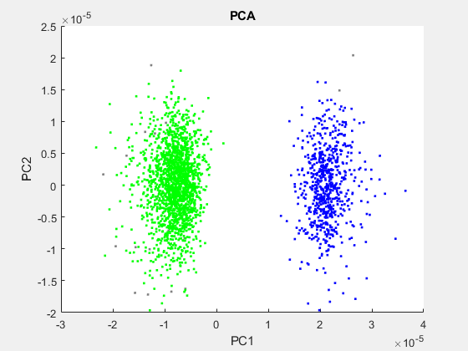
2-3-22_SampleElec_15min Electrode A6_31
All Valid WFs: | 2507
Unsorted WFs: | 21

Slide 9
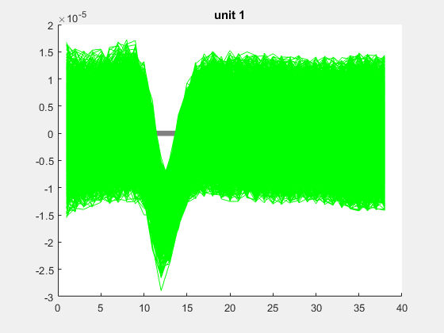
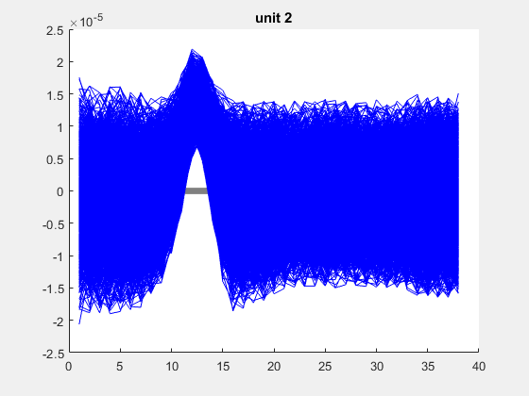
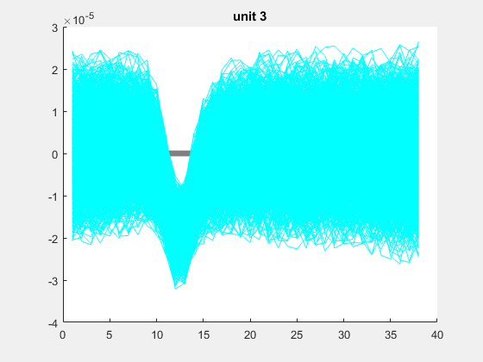
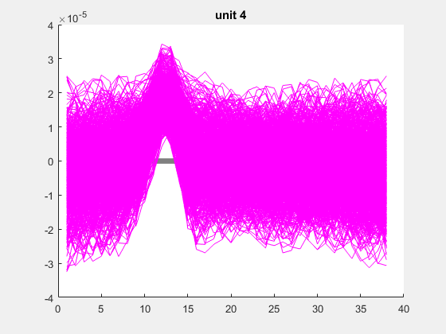
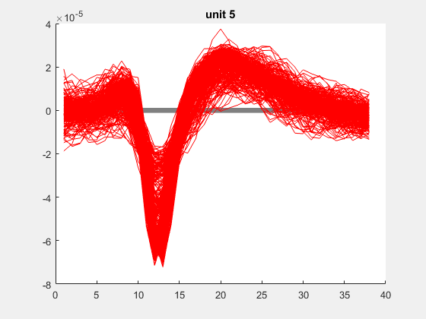
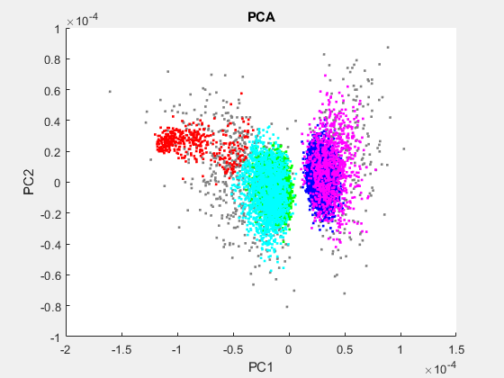
2-3-22_SampleElec_15min Electrode A6_33
All Valid WFs: | 15773
Unsorted WFs: | 910

Slide 10
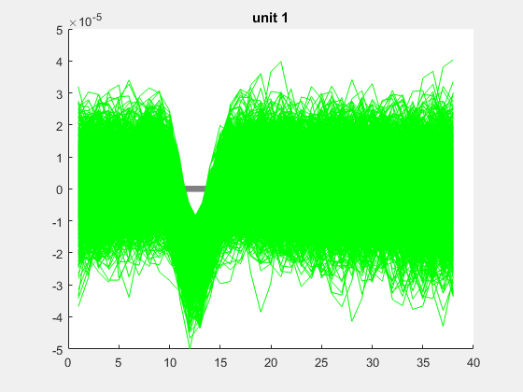
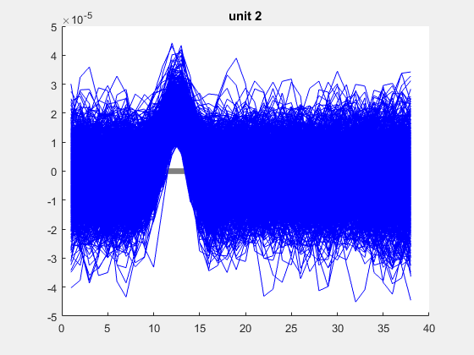
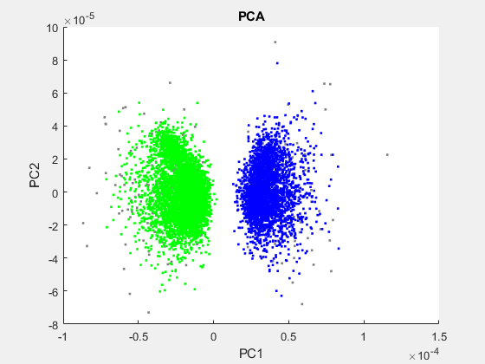
2-3-22_SampleElec_15min Electrode B4_11
All Valid WFs: | 9122
Unsorted WFs: | 282

Slide 11
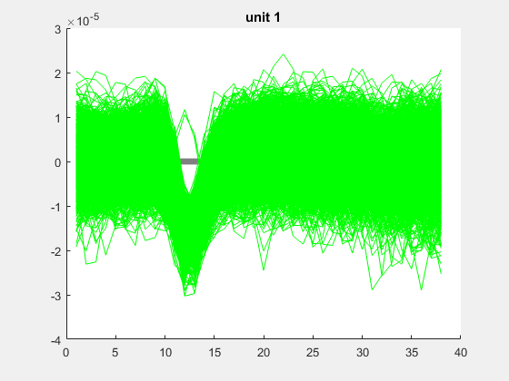
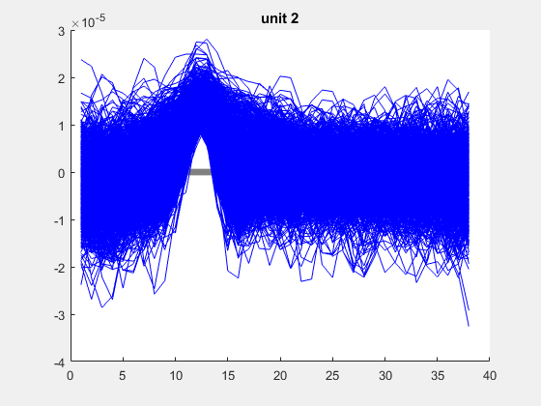
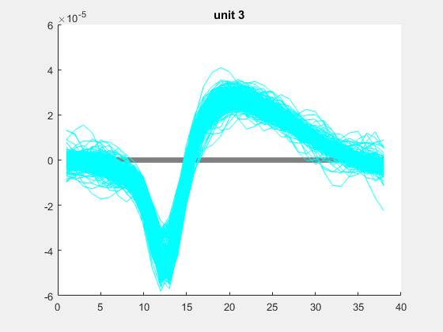
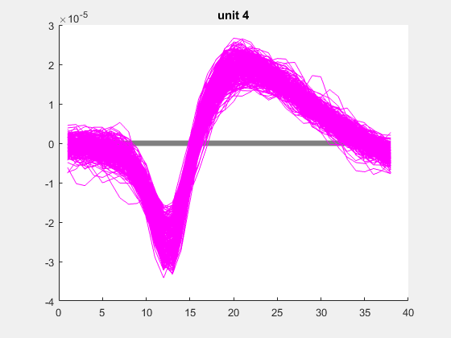
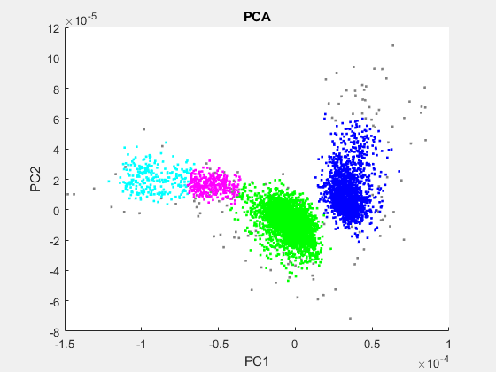
2-3-22_SampleElec_15min Electrode B4_12
All Valid WFs: | 6366
Unsorted WFs: | 218

Slide 12
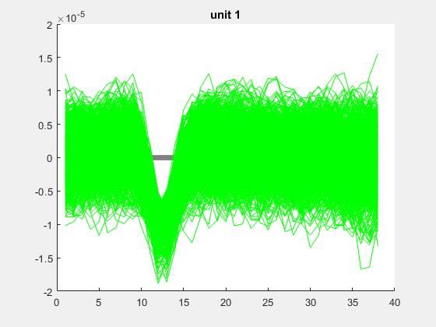
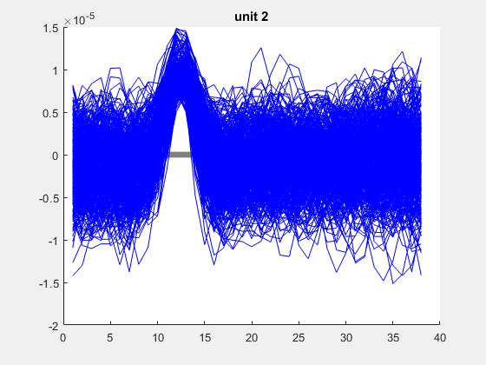
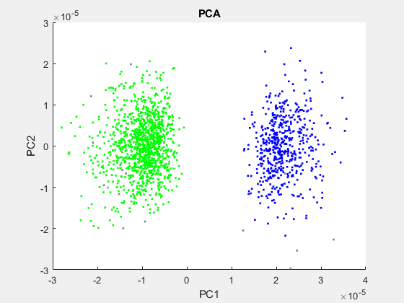
2-3-22_SampleElec_15min Electrode B4_13
All Valid WFs: | 1697
Unsorted WFs: | 17

Slide 13
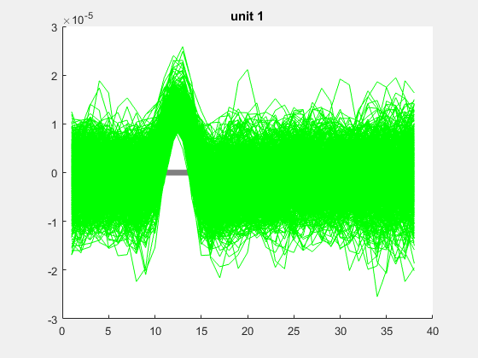
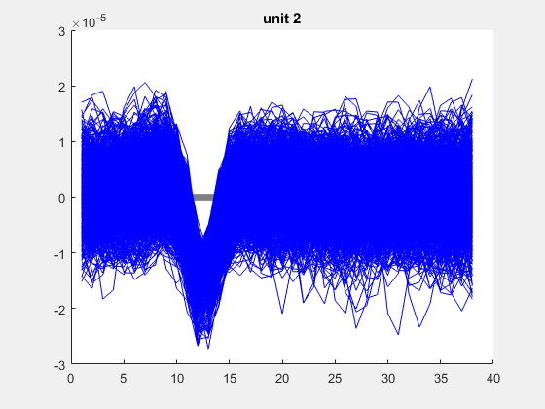
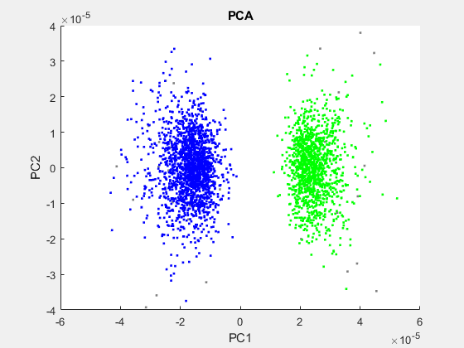
2-3-22_SampleElec_15min Electrode B4_21
All Valid WFs: | 3041
Unsorted WFs: | 51

Slide 14
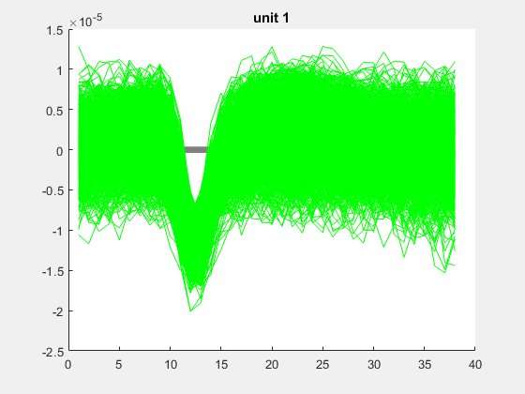
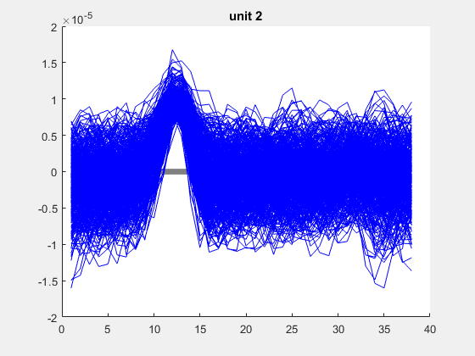
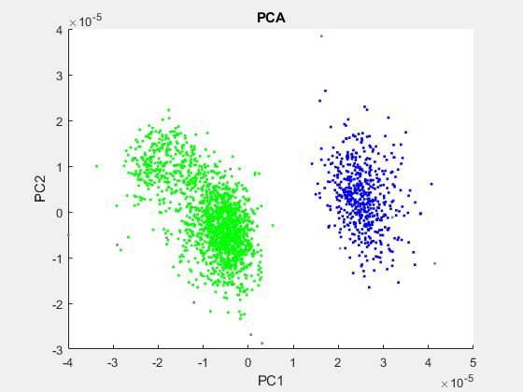
2-3-22_SampleElec_15min Electrode B4_22
All Valid WFs: | 2152
Unsorted WFs: | 25

Slide 15
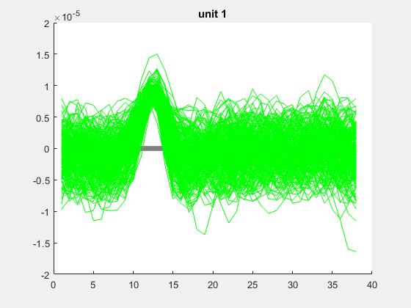
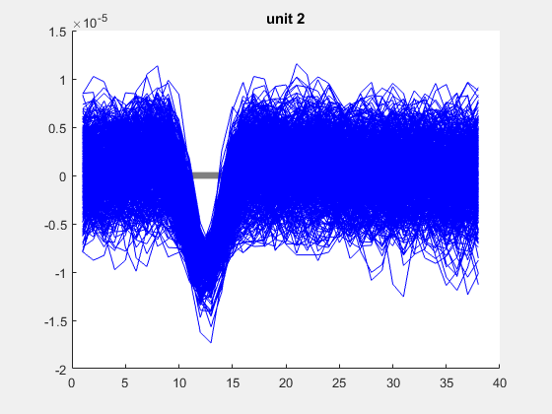
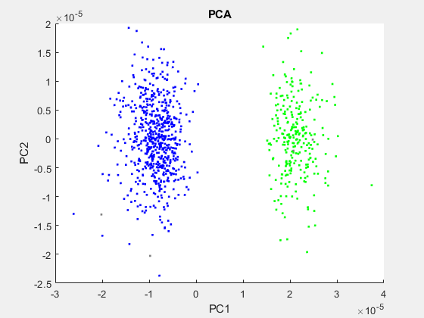
2-3-22_SampleElec_15min Electrode B4_23
All Valid WFs: | 905
Unsorted WFs: | 5

Slide 16
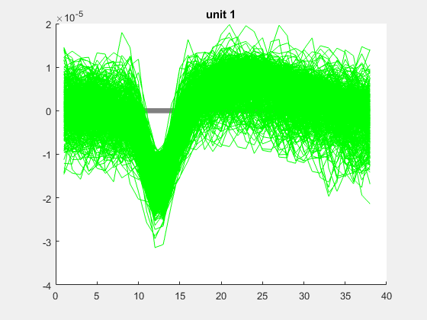
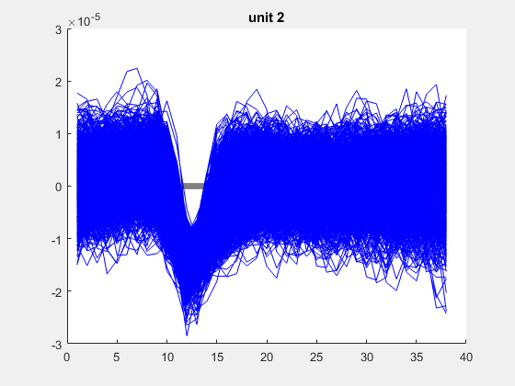
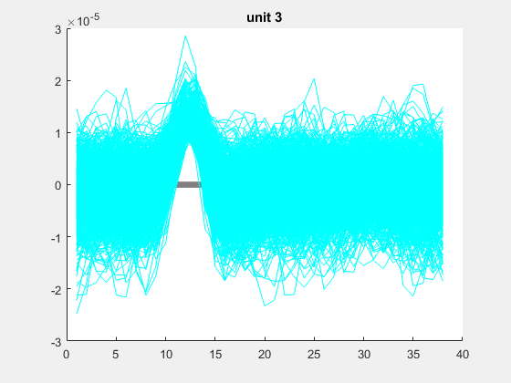
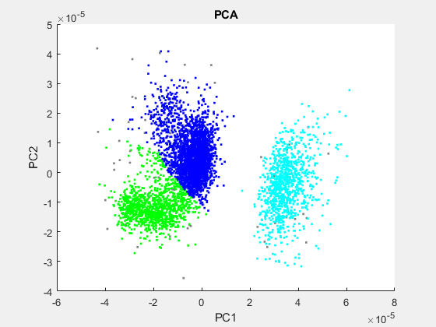
2-3-22_SampleElec_15min Electrode B4_31
All Valid WFs: | 4913
Unsorted WFs: | 80

Slide 17



2-3-22_SampleElec_15min Electrode B4_33
All Valid WFs: | 2868
Unsorted WFs: | 27

Slide 18



2-3-22_SampleElec_15min Electrode C3_11
All Valid WFs: | 1938
Unsorted WFs: | 101

Slide 19



2-3-22_SampleElec_15min Electrode C3_12
All Valid WFs: | 543
Unsorted WFs: | 6

Slide 20



2-3-22_SampleElec_15min Electrode C3_13
All Valid WFs: | 5720
Unsorted WFs: | 89

Slide 21



2-3-22_SampleElec_15min Electrode C3_21
All Valid WFs: | 1459
Unsorted WFs: | 11

Slide 22



2-3-22_SampleElec_15min Electrode C3_22
All Valid WFs: | 2791
Unsorted WFs: | 44

Slide 23



2-3-22_SampleElec_15min Electrode C3_23
All Valid WFs: | 4401
Unsorted WFs: | 59

Slide 24



2-3-22_SampleElec_15min Electrode C3_31
All Valid WFs: | 2222
Unsorted WFs: | 107

Slide 25





2-3-22_SampleElec_15min Electrode C3_33
All Valid WFs: | 19353
Unsorted WFs: | 4815

Slide 26



2-3-22_SampleElec_15min Electrode F5_12
All Valid WFs: | 525
Unsorted WFs: | 11

Slide 27




2-3-22_SampleElec_15min Electrode F5_22
All Valid WFs: | 622
Unsorted WFs: | 15

Slide 28






2-3-22_SampleElec_15min Electrode F5_23
All Valid WFs: | 14976
Unsorted WFs: | 860

Slide 29



2-3-22_SampleElec_15min Electrode F5_31
All Valid WFs: | 286
Unsorted WFs: | 10

Slide 30



2-3-22_SampleElec_15min Electrode F5_33
All Valid WFs: | 1425
Unsorted WFs: | 39

Slide 31




2-3-22_SampleElec_15min Electrode G1_11
All Valid WFs: | 1252
Unsorted WFs: | 122

Slide 32






2-3-22_SampleElec_15min Electrode G1_12
All Valid WFs: | 3082
Unsorted WFs: | 173

Slide 33





2-3-22_SampleElec_15min Electrode G1_21
All Valid WFs: | 2009
Unsorted WFs: | 46

Slide 34




2-3-22_SampleElec_15min Electrode G1_22
All Valid WFs: | 1605
Unsorted WFs: | 70

Slide 35




2-3-22_SampleElec_15min Electrode G1_31
All Valid WFs: | 3313
Unsorted WFs: | 272

Slide 36



2-3-22_SampleElec_15min Electrode H6_12
All Valid WFs: | 1376
Unsorted WFs: | 24

Slide 37




2-3-22_SampleElec_15min Electrode H6_13
All Valid WFs: | 1513
Unsorted WFs: | 83

Slide 38




2-3-22_SampleElec_15min Electrode H6_22
All Valid WFs: | 2493
Unsorted WFs: | 96

Slide 39


2-3-22_SampleElec_15min Electrode H6_23
All Valid WFs: | 225
Unsorted WFs: | 57

Slide 40




2-3-22_SampleElec_15min Electrode H6_31
All Valid WFs: | 5159
Unsorted WFs: | 128

Slide 41



2-3-22_SampleElec_15min Electrode H6_33
All Valid WFs: | 2423
Unsorted WFs: | 128

